Slide 1
COMPUTER SYSTEM: a tour
STUDENT ID: 4110E214
TEACHER: MY DEAR GREAT TEACHER

Slide 2
AGENDA
COMPUTER SYSTEM
COMPUTER HARDWARE
COMPUTER SOFTWARE: OPERATING SYSTEM

Slide 3
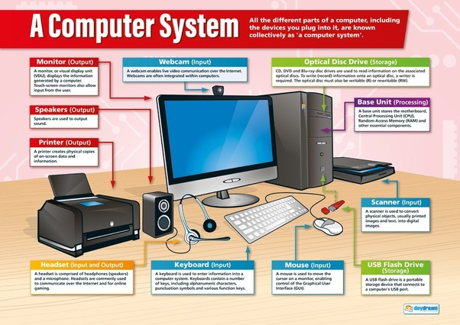

Slide 4
